Slide 1
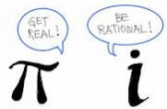
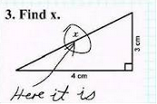
"Life is good for only two things, discovering mathematics and teaching mathematics“ Siméon Poisson Welcome to Geometry Honors Osprey Team at ODS Home of Brickell Academy
MRS. LI ROOM B309
xili@vbschools.com
Glad to meet you!

Slide 2
Geometry Honors Curriculum Overview
The Curriculum
Unit 1 Reasoning and Proof 8 Blocks
Unit 2 Foundations of Geometry 10 Blocks
Unit 3 Lines and Their Relationships 5 Blocks
Unit 4 Triangles and Their Relationships 11 Blocks
Unit 5 Proportions and Similarity 6 Blocks
Mid Year Assessment (January)
Unit 6 Right Triangles 7 Blocks
Unit 7 Polygons and Quadrilaterals 6 Blocks
Unit 8 Circles 8 Blocks
Unit 9 Area and Volume 6 Blocks
Unit 10 Transformations 5 Blocks
SOL Test (in May)
Advanced Math Topics/Algebra Review

Slide 3
Geometry Honors What to Be Happening in Class
What Is Going to be Happening in Class?
Students will explore properties and relationships of geometric figures through purposeful student centered, inquiry based, and technology enhanced learning activities. They will prove and build system of knowledge with the power of logical reasoning (remember proofs?). Students will create geometry constructions, measure figures, observe patterns, discuss findings, write own definitions, and formulate own conjectures, use geometric models to solve problems – In short, students will discover & construct in the processes
Students will develop problem solving and critical thinking skills, apply geometry to practical contexts (STEM), and connect their learning to advanced math. Instruction is concept-based and authentic in nature.

Slide 4
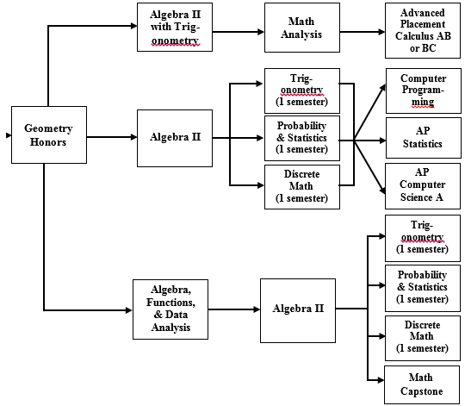
Geometry Honors Course Sequence
Course Sequence
Typical Course Sequence for students taking Geometry Honors in 8th grade(Note: other sequences are available):

Slide 5
Geometry Honors Course Info & Textbook
Course Info & Textbook
High School Credit Course; SOLs test in May
High school attendance policy applies (No more than 6 absences per semester, excused or unexcused)
Textbook (Online version not available)
-A class set of hard copies available in classroom
-A limited # of hardcopies & CDs available for
checkout upon request.
Online Resource for Geometry Constructions:
www.mathopenref.com: Visual step-by-step instructions

Slide 6
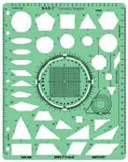
Geometry Honors Supplies
Supplies Needed
Compass (able to lock / non-slipping)
Ruler (cm and in)
Protractor
Online calculator: https://www.desmos.com/scientific
TI 83 /84 Plus calculator check out (optional)
Binder with dividers and graph paper
Pencils and colored pencils/pens
Geometer (Stencil) is optional →
Sample Compasses:
Make sure it holds / locks tight (non-slipping).

Slide 7
Geometry Grading and Extra Help
Grading and Extra Help
Grading System: Total Points based on a variety of
assessments (tests/quizzes, performance tasks,
constructions, etc.)
Grading focuses on process and correct answers.
Partial credit may be given if work is shown.
Some assessments may be completed at home.
Completing assignments is very important.
Corrections, if offered, is for students to re-learn concepts and improve grades.
Tutoring / Extra Help available after school on designated day(s). Extra help sessions available during lunch bells. Students can ask questions, get work caught up, or work on assignments.

Slide 8
Geometry Honors Assignments
Assignments / Homework
All assignments are purposeful and meaningful.
HW: Extension of class or Reinforcement of concepts / skills
Not completing HW will impact grades. Why?
although homework does not count in grading
Daily HW (why) Posted on board. Check online, Due next day
HW: Finish classwork. Paper is both Notes and skills practice
Show Work: Beneficial to learning (teacher feedback)
- Thoughtfully attempt all problems
- Show steps needed to justify the answer
- Sketch / mark a diagram for figuring
- Check/Correct work with key. Ask Qs.
Start HW the night it is assigned. Talk to teacher if special situation
Ask clarifying questions. Refer to key concepts, examples, Come for help next day.

Slide 9
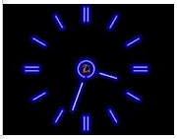
Geometry Honors Communication & Parent Support
How Can Parents Facilitate Student Success?
Communicate timely: I am open to suggestions / ideas.
Happy to hear from you. Email is: xili@vbschools.com
Stay informed: Class portal, ParentPortal, MySchool Mail
Is my student completing assignments regularly and
seeking clarification / help when needed?
Be a Growth Mindset coach – Effort matters most.
Time management helps.
Model resilience: Diligence + Persistence = Growth
Learning is a process of making mistakes and learning form them. If you are not making any mistakes, you are not learning. In this class risk-taking and creativity are encouraged. It’s safe to ask questions and make mistakes. Students are encouraged to keep working hard and persist through. No giving up easily.

Slide 10
Academy Application & Teacher Recommendations
Academy Application Due January (Guidance kicks off)
Academic Performance in Semester One Matters

Slide 11
Academy Application & Teacher Recommendations
Work Towards a Strong Academy
Application Starts the First Day of School
Teachers Will Be Observing the Following Traits:
Ease of Learning: Enjoy/Meet challenges
Adaptability: Apply diverse approaches to problem solving
Initiative & Enthusiasm: Motivated, independent, enthusiastic
Persistence: Stay with tasks; Take steps to reach a bigger goal
Reliability and Integrity: Live up to the Brickell Honor code
Reasoning: Logical, analytical, creative, divergent
Communication: Engage in discussion, communicate effectively
Organization: Time management, deadlines, goal setting
Leadership Qualities: Respect/tolerate others’ views, contribute
to group processes, positive influence
Success: Display the ability to succeed in a challenging program

Slide 12
Geometry Honors That’s All for Tonight
We Are Going to Have a Great Year!
Team work is important. Your support and encouragement will make a difference.
Any questions? I am always an e-mail away!
xili@vbschools.com
Thanks
Have a good night!

